Slide 1
WELCOME
FALL 2023

Slide 2
Thank You!
We’re glad you’re here!
Dr. Suzanne Bausch
VP of Research & Business Engagement and
Dean, Graduate School
Dr. Marnie Saunders
Sr. Assoc. Dean, the Graduate School
Professor, Dept. of Biomedical Engineering
Deborah Phillipp
Dir., Graduate Admissions & Student Services

Slide 3
AGENDA TOPICS
Orientation - New Assistantship awardees
Graduate School Overview
Resources & Events
  Teaching in the Classroom
  Health Services
  Testing & Counseling
  Parking & Transportation
  Financial Aid
  Getting Involved
  ZipAssist
GA Guidelines & Expectations
  Student Code of Conduct and Title IX
  Eligibility
  Payroll

Slide 4
AGENDA TOPICS
Orientation - New Assistantship awardees
Graduate School Overview
  Where
  Who
  What

Slide 5
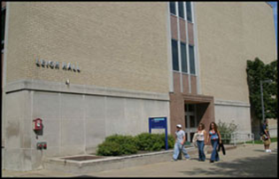


Graduate school overview
Office Location
The Graduate School
Leigh Hall, Room 515
Akron, OH 44325-2101
330-972-7663
gradsch@uakron.edu

Slide 6
Graduate school overview
Staff
Ms. Heather Blake – Curriculum Support
Ms. Deborah Phillipp – Admissions, Graduation
Mr. William Walker – Student Services Counselor

Slide 7


Guidelines & Expectations
The Graduate Assistant Handbook
Currently under construction

Slide 8
AGENDA TOPICS
Orientation - New Assistantship awardees
Guidelines & Expectations
  Eligibility
  Fee remission
  Research

Slide 9
Guidelines & Expectations
Eligibility for an Assistantship Award
Full Admission to a Graduate Program
You must be enrolled as a full-time student during each semester you are working under contract.
Full-time definition
  Fall and Spring – minimum of 9 hours
  Summer – minimum of 6 hours
Maintain a minimum cumulative 3.0 GPA and progressing toward degree completion
Maximum work hours may not exceed 20 hours/per week
  Students may not hold additional employment if on a full-time assistantship

Slide 10
Guidelines & Expectations
Maintaining an Assistantship Award
You are required to perform your duties satisfactorily
You must maintain the standards of academic conduct
You must honor the terms of your contract agreement
If a TA – you must meet the minimum oral proficiency requirement
  23 – TOEFL Speaking Component (Internationals)
  Assessed by departmental procedures (Domestics)
If you give up your assistantship – you also give up the tuition waiver – repayment is required (after Census date)

Slide 11
Guidelines & Expectations
FEE REMISSION FOR ASSISTANTSHIP AWARDEES
UA shall provide a scholarship during each semester or summer session of award.
Scholarships are not provided for:
undergraduate/audit courses
professional fees
administrative fees
facilities fees
technology fees
drop/add fees
library fees
miscellaneous fees
general service fees
late registration fees
tuition/fees at other institutions

Slide 12

Guidelines & Expectations
OFFICE OF RESEARCH ADMINISTRATION
https://www.uakron.edu/research/ora/

Slide 13
AGENDA TOPICS
New Graduate Assistant Orientation
Resources
  Parking
  &
  Transportation

Slide 14

resources
  Parking permits
  Lot/Deck information
  Shuttle services
  Maps & routes
www.uakron.edu/parking

Slide 15



resources

Slide 16
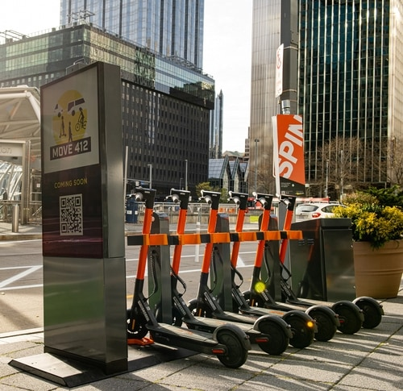
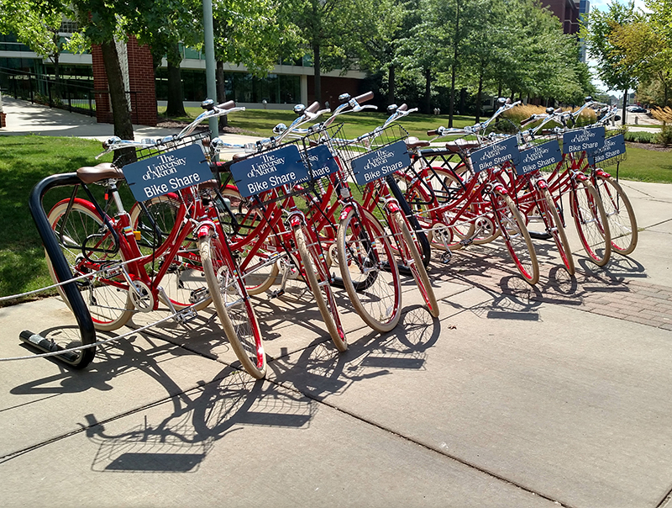
resources
Bike Share
www.uakron.edu/bikeshare
Scooters

Slide 17
AGENDA TOPICS
Orientation - New Assistantship awardees
Events / Things to do
  Get
  Involved

Slide 18
Events
Spring Semester
Graduate Student Appreciation Week
April 8 – 13, 2024
Professional development and fun activities
More details to come…

Slide 19

Events each Semester
Writing your Thesis or Dissertation
Plagiarism
References
Citations
Literature
Formatting
Workshop dates T.B.A.

Slide 20

Events each Semester
www.uakron.edu/exl/

Slide 21

Events get involved!

